Slide 1
Attention in Deep Neural Networks

Slide 2
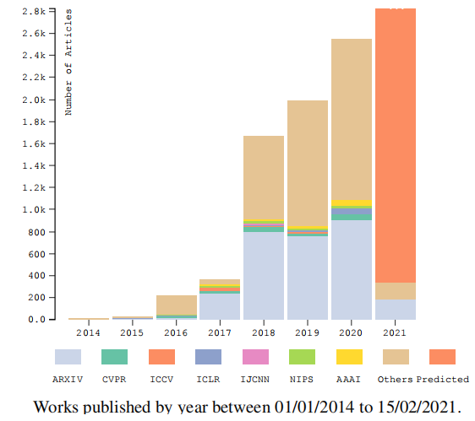
Attention
Attention mechanisms select, modulate, and focus on the information most relevant to behavior.
Behavioral and cognitive process: focusing selectively on a discrete aspect of information, ignoring other perceptible information.
Operate throughout the brain and are involved in almost every stage, broad term to define how the brain controls its information processing.

Slide 3
Contents
Development Stages
Attention Categories
Attention-based Deep Neural Network (DNN) Architectures
Attention-based CNNs
Attention-based RNNs
Applications in CV
Trends and Opportunities

Slide 4
Development Stages

Slide 5
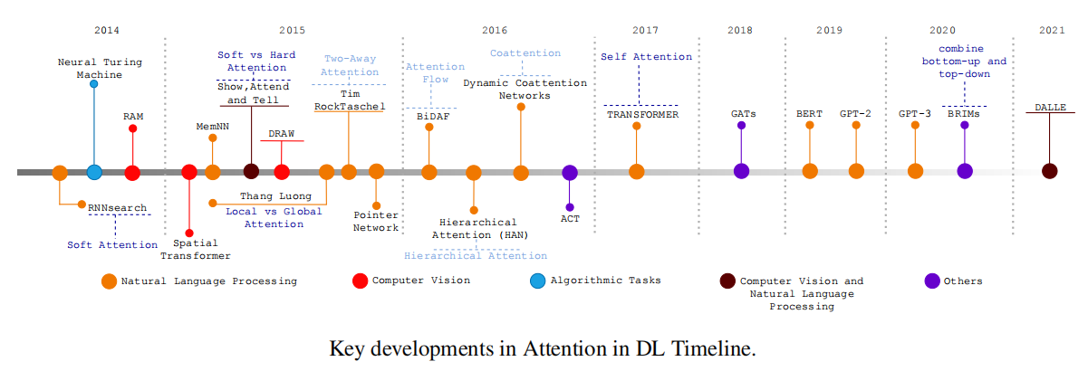
Initial motivation: bottleneck problem in the classic encoder-decoder framework.
Main issue: neural network needs to compress all the necessary information from a source sentence into a fixed-length vector. Performance deteriorates rapidly as the size of the input sentence increases.

Slide 6
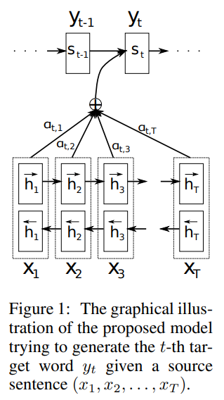
RNNSearch
RNNSearch generates a translated word at each time-step, looking for a set of positions in the source sentence with the most relevant words.
The main advantage: not encode an entire input sentence into a single fixed-length vector. Instead, it encodes the input sentence into a sequence of vectors, choosing a subset of these vectors adaptively while generating the translation. The attention mechanism allows extra information to be propagated through the network, eliminating the fixed-size context vector’s information bottleneck.
RNNSearch introducing the first attention mechanism, soft attention.
Dzmitry Bahdanau, Kyunghyun Cho, and Yoshua Bengio. Neural machine translation by jointly learning to align and translate. arXiv preprint arXiv:1409.0473, 2014.

Slide 7
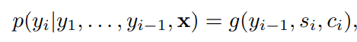
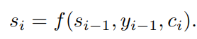
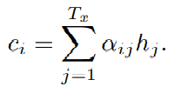
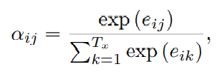
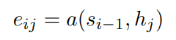
RNNSearch

Slide 8
RAM and STN
Attentional interfaces: based on human saccadic movements and robustness to change. One person focuses attention on parts of the image simultaneously, glimpsing to quickly scan the entire image to find the main areas during the recognition process. Ignoring the irrelevant parts makes it easier to learn in the presence of disorder.
CNNs are rigid, and the number of parameters grows linearly with the size of the image. Besides, the network treats all pixels in the same way.
RAM and STN are pioneering architectures with attentional interfaces based on human visual attention. RAM (Recurrent Attention Model) can extract information from an image or video by adaptively selecting a sequence of regions, glimpses, only processing the selected areas at high resolution. STN (Spatial Transformer Network) is a module robust to spatial transformation changes, and is a dynamic mechanism that can spatially transform an image, or feature map, producing the appropriate transformation for each input sample.

Slide 9
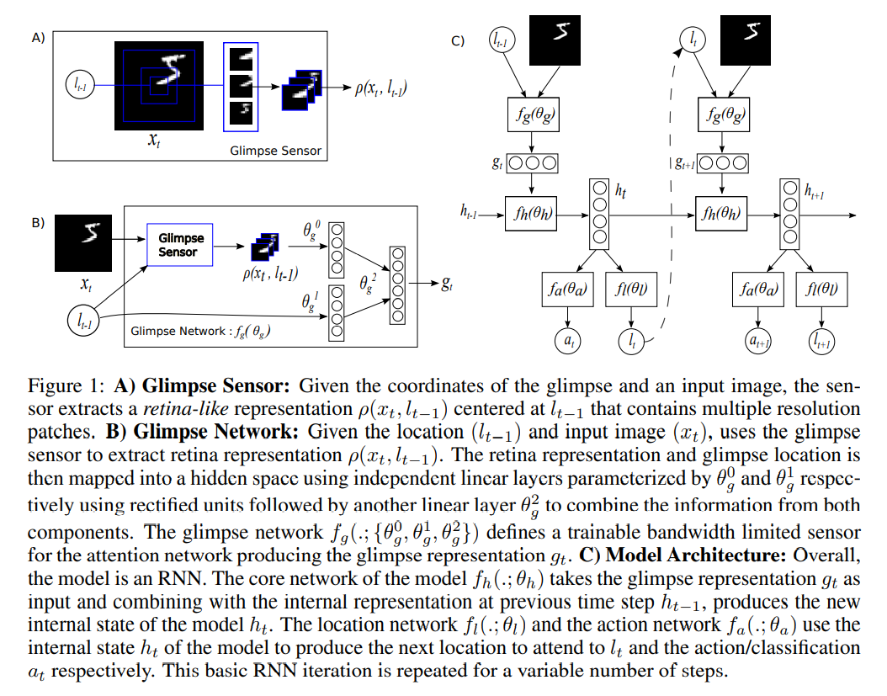
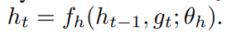
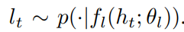
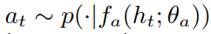
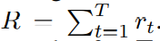
RAM
Internal state:
Location Action:
Environment Action:
Reward:
Partially Observable Markov Decision Process (POMDP)
Volodymyr Mnih, Nicolas Heess, Alex Graves, and Koray Kavukcuoglu. Recurrent models of visual attention.arXiv preprint arXiv:1406.6247, 2014.

Slide 10
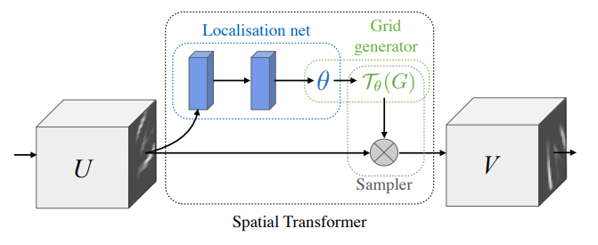
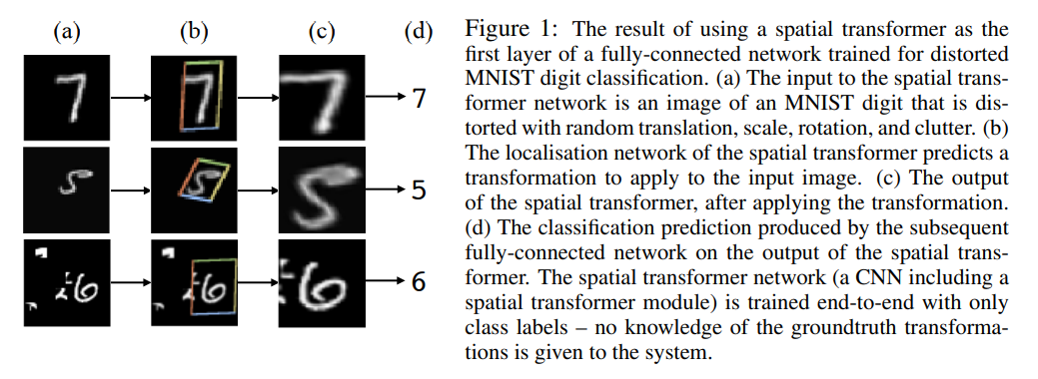
STN
Max Jaderberg, Karen Simonyan, Andrew Zisserman, and koray kavukcuoglu. Spatial transformer networks. In C. Cortes, N. D. Lawrence, D. D. Lee, M. Sugiyama, and R. Garnett, editors, Advances in Neural Information Processing Systems 28, pages 2017–2025. Curran Associates, Inc., 2015.

Slide 11
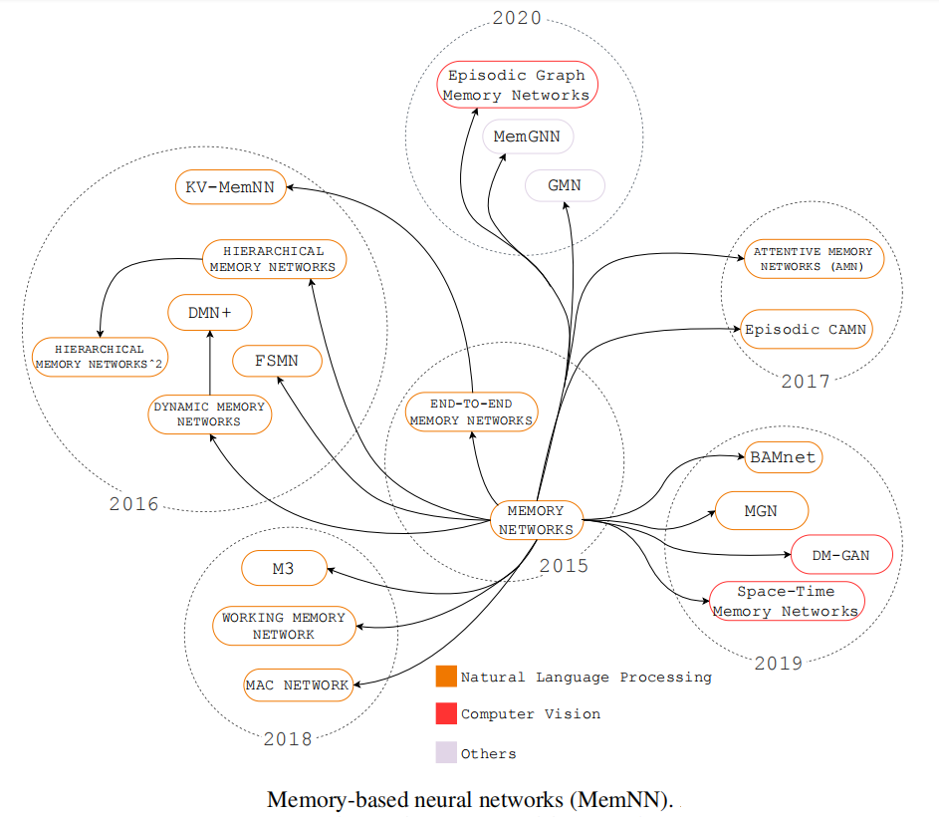
Attention-augmented memory
Attentional interfaces also allow the neural network iteration with other cognitive elements (i.e., memories, working memory).
Neural Turing Machine (NTM) and Memory Networks (MemNN) introduced the possibility dealing with addressable memory.
Memory Networks are a relatively new framework of models designed to alleviate the problem of learning long-term dependencies in sequential data by providing an explicit memory representation for each token in the sequence.

Slide 12
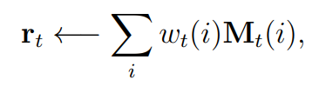
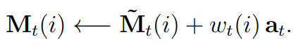
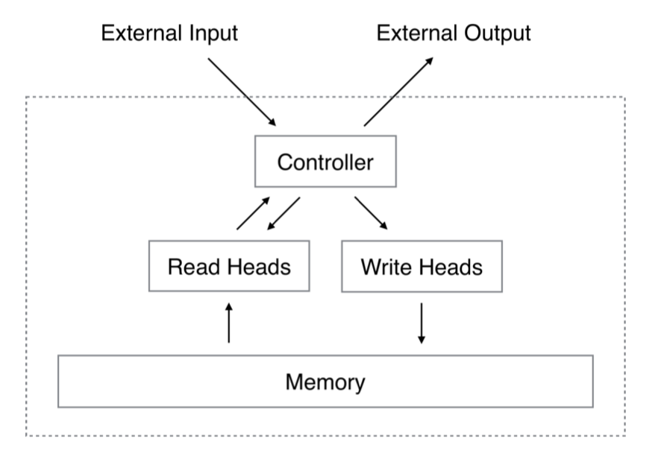
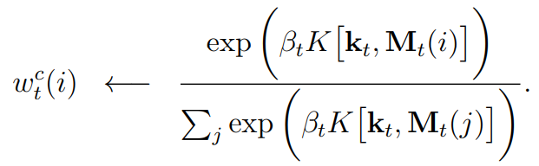
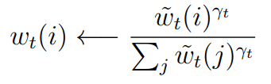
NTM
Reading:
Writing:
Content-addressing:
Location-addressing:
Controller: RNN
Alex Graves, Greg Wayne, and Ivo Danihelka. Neural turing machines. arXiv:1410.5401 [cs], October 2014. arXiv: 1410.5401.

Slide 13
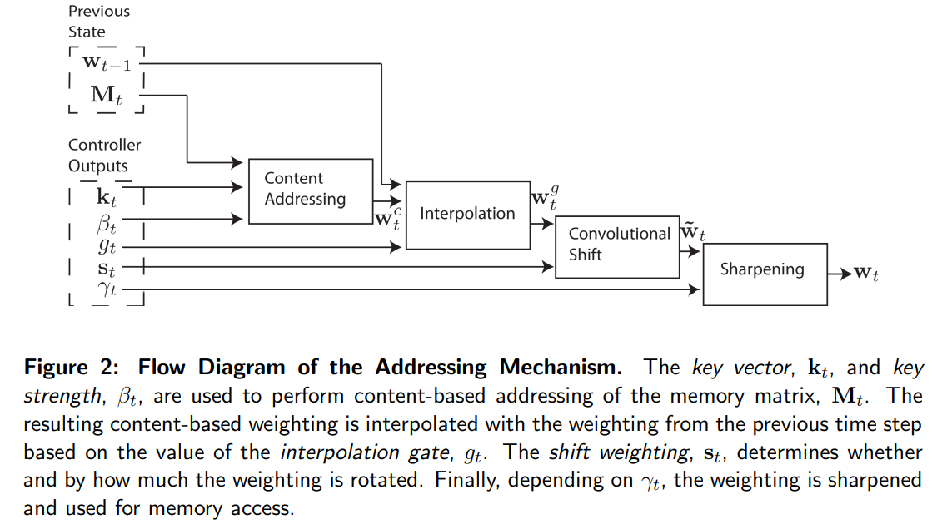
NTM

Slide 14
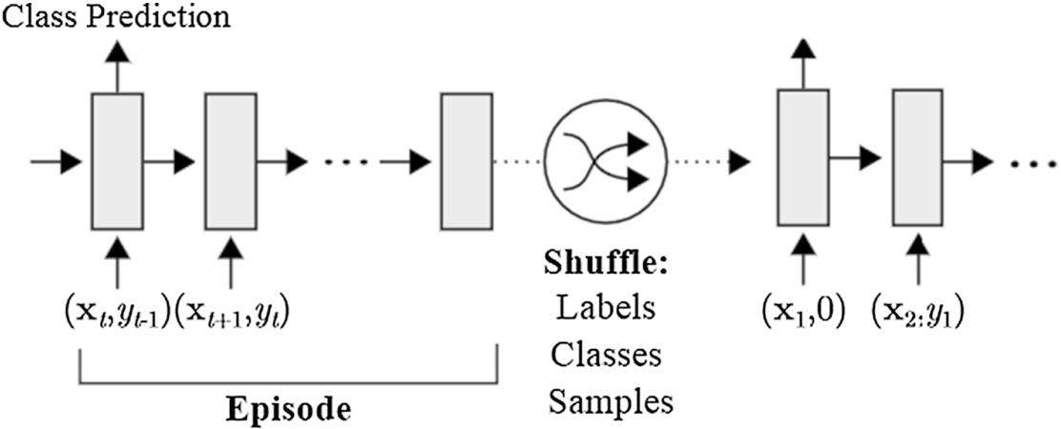
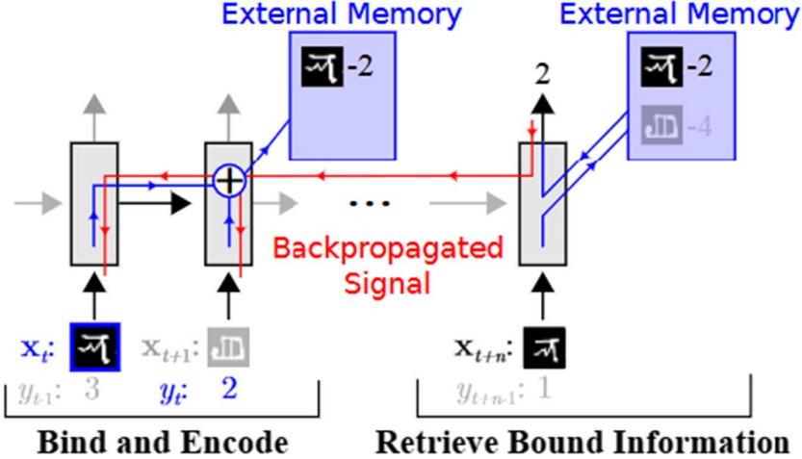
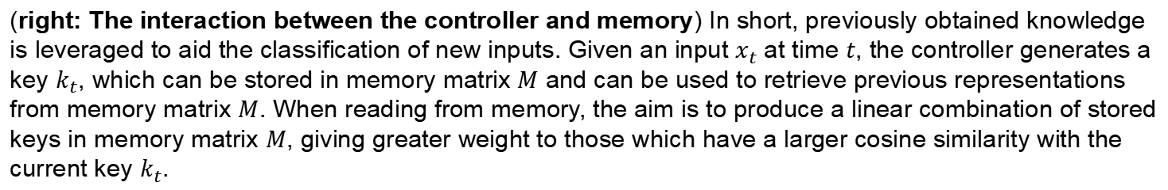
MANN
The key idea of memory-augmented neural networks (MANNs) is to enable neural networks to learn quickly with the help of an external memory. Santoro et al. used Neural Turing Machines.
(right: The interaction between the controller and memory) In short, previously obtained knowledge is leveraged to aid the classification of new inputs. Given an input $x_{t}$ at time $t$, the controller generates a key $k_{t}$, which can be stored in memory matrix $M$ and can be used to retrieve previous representations from memory matrix $M$. When reading from memory, the aim is to produce a linear combination of stored keys in memory matrix $M$, giving greater weight to those which have a larger cosine similarity with the current key $k_{t}$.
Mark Collier, Joeran Beel. Memory-Augmented Neural Networks for Machine Translation. arXiv:1909.08314 [cs], Wed, 18 Sep 2019. arXiv: 1909.08314.

Slide 15
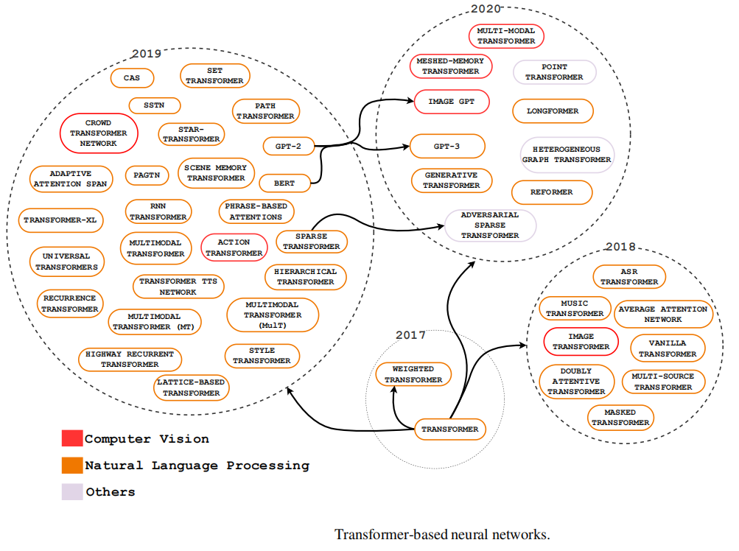
End-to-end attention models
The Neural Transformer (NT) and Graph Attention Networks - purely attentional architectures -demonstrated to the scientific community that attention is a key element for the future development in Deep Learning.
The Transformer’s goal is to use self-attention to minimize traditional recurrent neural networks’ difficulties.
Graph Attention Networks (GATs) are an end-to-end attention version of GNNs. They have stacks of attentional layers that help the model focus on the unstructured data’s most relevant parts to make decisions.

Slide 16
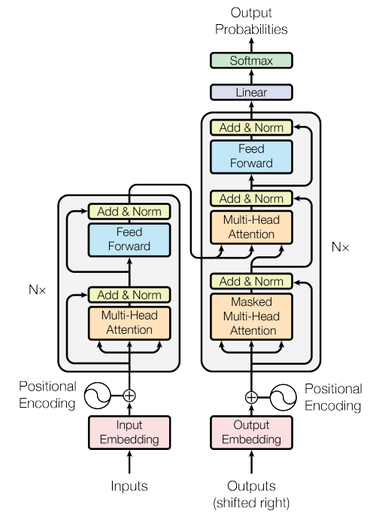
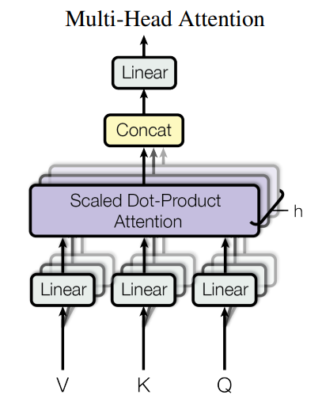
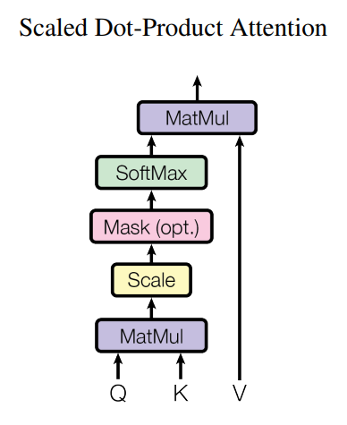
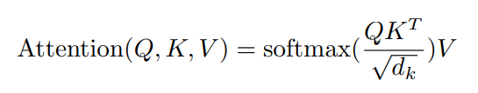
Transformer
Ashish Vaswani, Noam Shazeer, Niki Parmar, Jakob Uszkoreit, Llion Jones, Aidan N. Gomez, Lukasz Kaiser, and Illia Polosukhin. Attention is all you need. arXiv:1706.03762 [cs], June 2017. arXiv: 1706.03762.

Slide 17
Transformer：using in three ways
In "encoder-decoder attention" layers, the queries come from the previous decoder layer, and the memory keys and values come from the output of the encoder. This allows every position in the decoder to attend over all positions in the input sequence.
The encoder contains self-attention layers. In a self-attention layer all of the keys, values and queries come from the same place, in this case, the output of the previous layer in the encoder. Each position in the encoder can attend to all positions in the previous layer of the encoder.
Similarly, self-attention layers in the decoder allow each position in the decoder to attend to all positions in the decoder up to and including that position. We need to prevent leftward information flow in the decoder to preserve the auto-regressive property.

Slide 18
Attention Categories

Slide 19
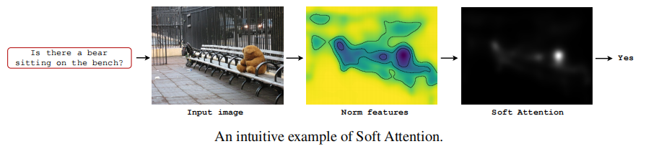
Soft Attention (Global Attention)
Assigns a weight of 0 to 1 for each input element. It decides how much attention should be focused on each element.
It uses softmax functions in the attention layers to calculate weights so that the entire attentional model is deterministic and differentiable.
It have a high computational cost for large inputs.

Slide 20
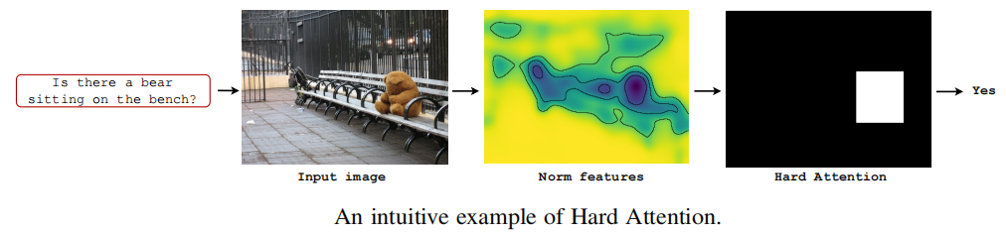
Hard Attention (Local Attention)
Hard attention determines whether a part of the mechanism’s input should be considered or not.
The weight assigned to an input part is either 0 or 1.
As the model is not differentiable, reinforcement learning techniques are necessary to train models with hard attention. Inference time and computational costs are reduced compared to soft mechanisms once the entire input is not being stored or processed.

Slide 21
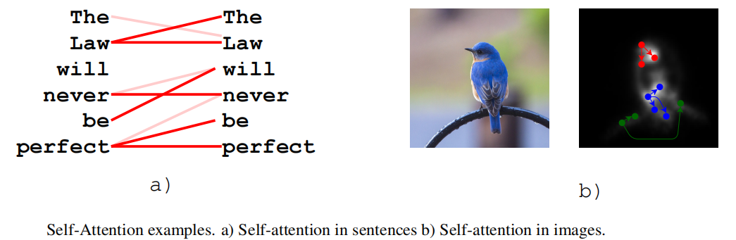
Self-Attention (Intra-Attention)
This mechanism allows the inputs to interact with each other "self" and determine what they should pay more attention to.
The self-attention layer’s main advantages compared to soft and hard mechanisms are parallel computing ability for a long input. This mechanism layer checks the attention with all the same input elements using simple and easily parallelizable matrix calculations.

Slide 22
Attention-based CNN Architectures

Slide 23
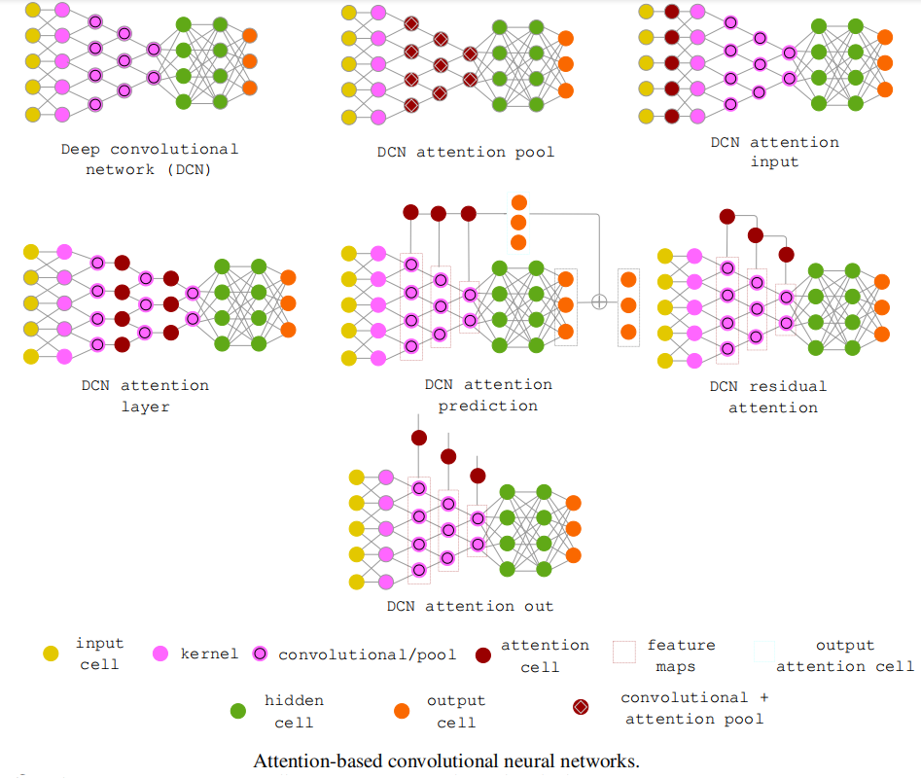
1) DCN attention pool – attention replaces the classic CNN pooling mechanism;
2) DCN attention input – the attentional modules are filter masks for the input data, assigns low weights to regions irrelevant to neural network processing and high weights to relevant areas;
3) DCN attention layer – attention is between the convolutional layers;
4) DCN attention prediction – attentional mechanisms assist the model directly in the prediction process;
5) DCN residual attention – extracts information from the feature maps and presents a residual input connection to the next layer;
6) DCN attention out – attention captures important stimuli of feature maps for other architectures, or other instances of the same architecture.

Slide 24
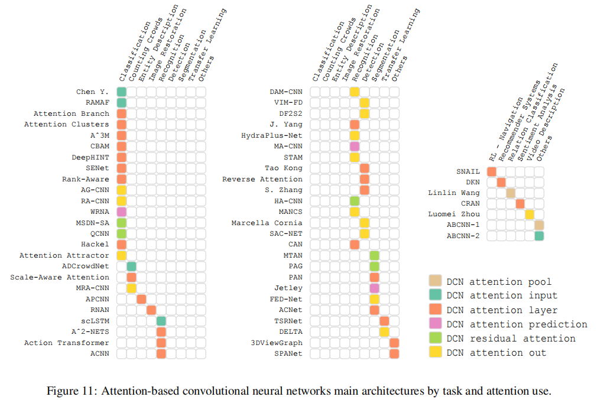

Slide 25
DCN attention input
A structure similar to the multi-glimpse mechanism and visual attention of human beings. Multi-glimpse: ability to quickly scan the entire image and find the main areas relevant to the recognition process; Visual attention: focuses on a critical area by extracting key features to understand the scene.
Attention in CNNs’ input contributes to increasing robustness in several ways: 1) It makes architectures more scalable, in which the number of parameters does not vary linearly with the size of the input image; 2) Eliminates distractors; 3) Minimizes the effects of changing camera lighting, scale, and views; 4) It allows the extension of models for more complex tasks, i.e., fine-grained classification or segmentation; 5) Simplifies CNN encoding; 6) Facilitates learning by including relevant priorities for architecture.

Slide 26
DCN attention input
Zhao et al. used visual attention-based image processing to generate the focused image. Then, the focused image is input into CNN to be classified.
Wang et al. used attention to create representations rich in motion information for action recognition. The attention extracts saliency maps using both motion and appearance information to calculate the objectness scores.
Liu et al. used attention as input of a CNN to provide important priors in counting crowded tasks. An attention map generator first provides two types of priors for the system: candidate crowd regions and crowd regions’ congestion degree.

Slide 27
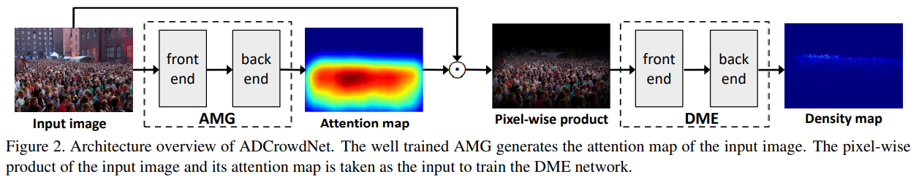
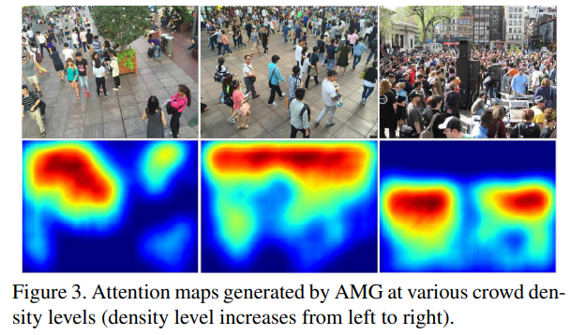
Liu et al.: ADCrowdNet
Ning Liu, Yongchao Long, Changqing Zou, Qun Niu, Li Pan, and Hefeng Wu. Adcrowdnet: An attention-injective deformable convolutional network for crowd understanding. In Proceedings of the IEEE/CVF Conference on Computer Vision and Pattern Recognition, pages 3225–3234, 2019.

Slide 28
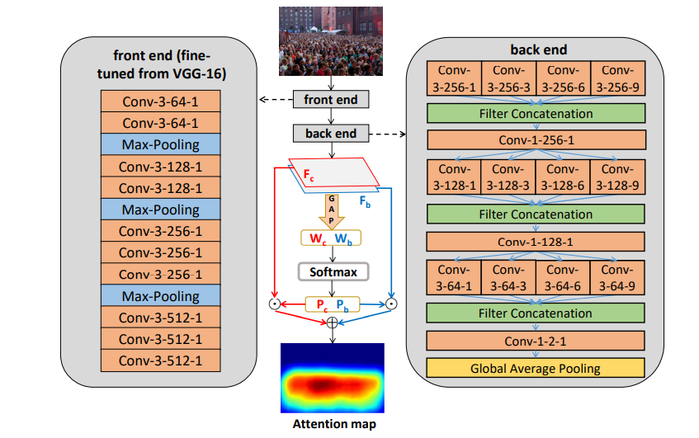
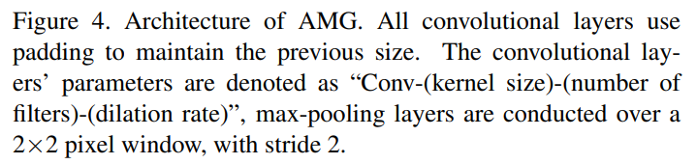
Liu et al.: ADCrowdNet

Slide 29
DCN attention layer&DCN residual attention
Classic CNNs: size of the receptive fields is relatively small; fail to capture long-range dependencies between pixels throughout the image; treat channel features equally and lacks the flexibility to deal with low and high-frequency information.
To mitigate such problems, use attention between convolutional layers (i.e., DCN attention layer and DCN residual attention). Between layers, attention acts mainly for feature recalibration, capturing long-term dependencies, internalizing, and correctly using past experiences.

Slide 30
DCN attention layer&DCN residual attention
Pioneering approach to adopting attention between convolutional layers: Squeeze-and-Excitation Networks. First architecture to model channel interdependencies to recalibrate filter responses in two steps, squeeze and excitation, i.e., SE blocks.
To explore local dependencies, the squeeze module encodes spatial information into a channel descriptor. The output is a collection of local descriptors with expressive characteristics for the entire image. To make use of the information aggregated by the squeeze operation, excitation captures channel-wise dependencies by learning a non-linear and non-mutually exclusive relationship between channels, ensuring that multiple channels can be emphasized.

Slide 31
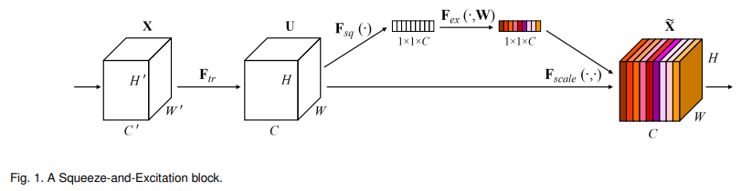
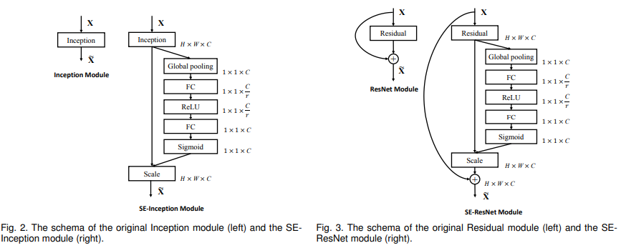
DCN attention layer&DCN residual attention
J. Hu, L. Shen, S. Albanie, G. Sun, and E. Wu, “Squeeze-and excitation networks,” 2019.

Slide 32
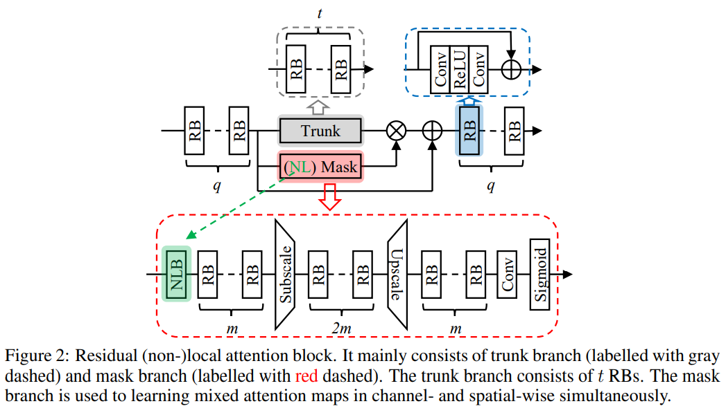
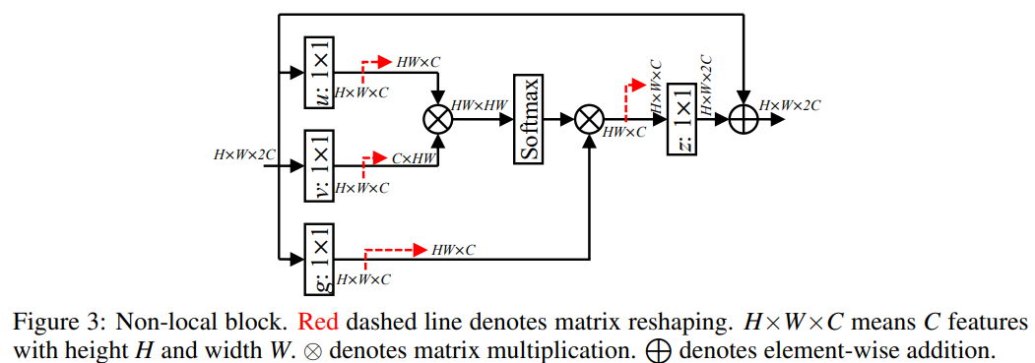
DCN attention layer&DCN residual attention
Zhang et al. proposed residual local and non-local attention blocks consisting of trunk and mask branches. Their attention mechanism helps to learn local and non-local information from the hierarchical features, further preserving low-level features while maintaining a representational quality of high-level features.
Yulun Zhang, Kunpeng Li, Kai Li, Bineng Zhong, and Yun Fu. Residual non-local attention networks for image restoration. arXiv preprint arXiv:1903.10082, 2019.

Slide 33
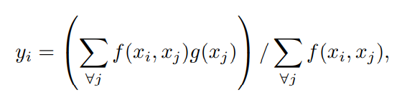
Zhang et al.: residual non-local attention

Slide 34
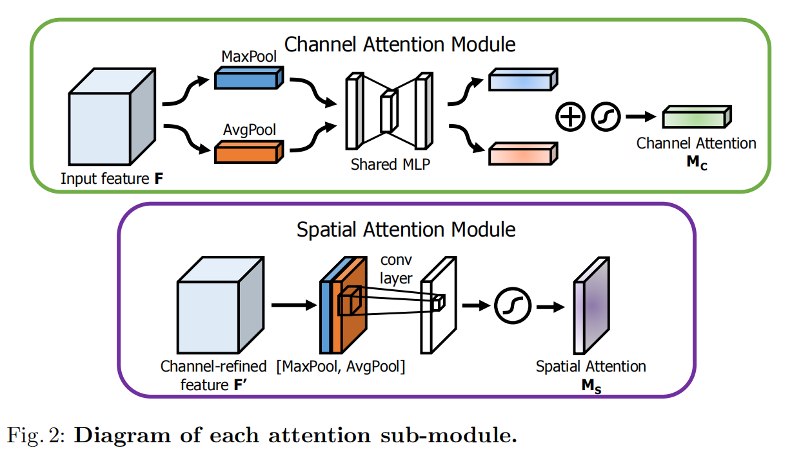
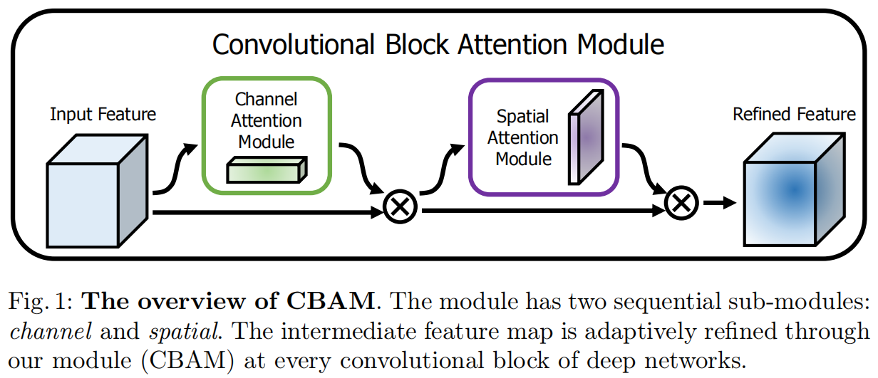
DCN attention layer&DCN residual attention
The CBAM infers attentional maps in two separate dimensions, channel and spatial, for adaptive feature refinement.
S. Woo, J. Park, J. Lee, and I. S. Kweon, “CBAM: convolutional block attention module,” in Computer Vision - ECCV 2018 - 15th European Conference, Munich, Germany, September 8-14, 2018, Proceedings, Part VII, ser.

Slide 35
DCN attention output
The DCN attention out-group uses attention to share relevant feature maps with other architectures or even with instances of the current architecture. In some cases, attention regularly works by turning classic CNNs into recurrent convolutional neural networks.
RA-CNN is a pioneering framework for recurrent convolutional networks. In their framework, attention proceeds along two dimensions, i.e., discriminative feature learning and sophisticated part localization.
Tian et al. used feature pyramid-based attention to combine meaningful semantic features with semantically weak but visually strong features in a face detection task. Their attention mechanism can fuse different feature maps from top to bottom recursively by combining transposed convolutions and element-wise multiplication maximizing mutual information between the lower and upper-level representations.

Slide 36
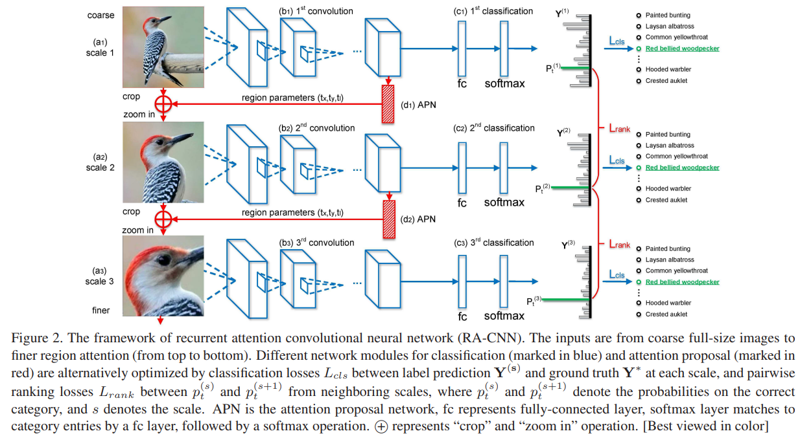
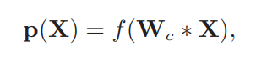
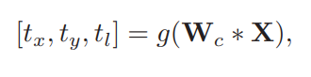
RA-CNN
Attention Proposal Network:
Category prediction:
Location (Box) prediction:
Jianlong Fu, Heliang Zheng, and Tao Mei. Look closer to see better: Recurrent attention convolutional neural network for fine-grained image recognition. In 2017 IEEE Conference on Computer Vision and Pattern Recognition (CVPR), pages 4476–4484, Honolulu, HI, July 2017. IEEE.

Slide 37
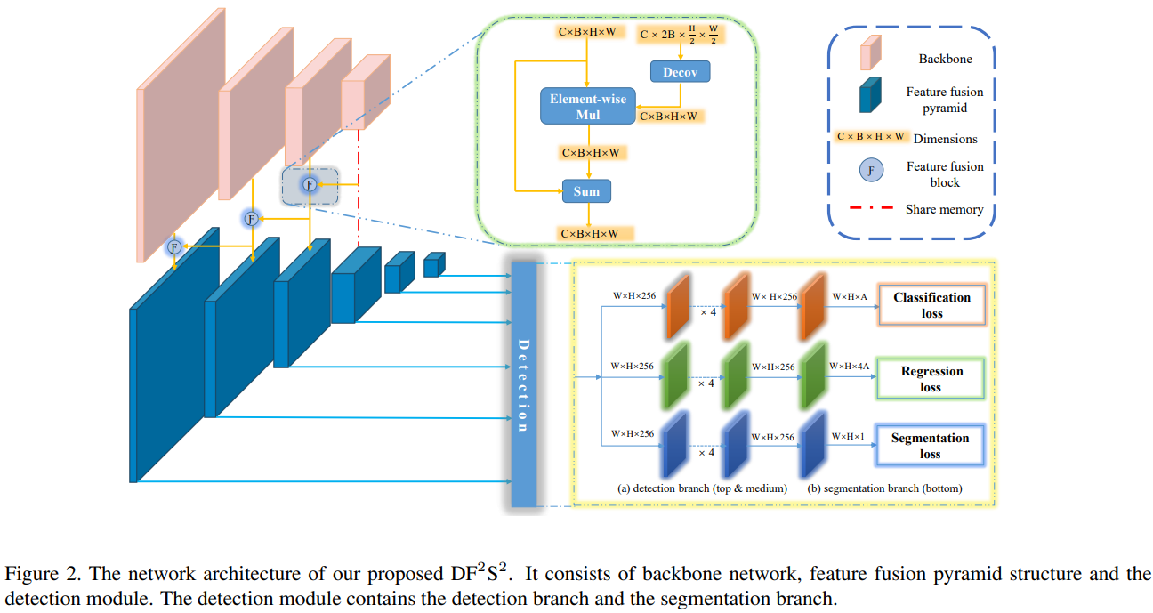
Pyramid based Attention

Slide 38

DCN attention prediction group
Uses attention directly in the prediction process. Zheng et al. proposed a multi-attention mechanism to group channels, creating part classification sub-networks. The mechanism takes as input feature maps from convolutional layers and generates multiple single clusters spatially-correlated subtle patterns as a compact representation.
channel grouping and weighting
spatial pooling on each channel
Heliang Zheng, Jianlong Fu, Tao Mei, and Jiebo Luo. Learning multi-attention convolutional neural network for fine-grained image recognition. In Proceedings of the IEEE international conference on computer vision, pages 5209–5217, 2017.

Slide 39


DCN attention pool group
DCN attention pool group replaces classic pooling strategies with attention-based pooling. Wang et al. created an attentional mechanism that captures pertinent relationships between convoluted context windows and the relation class embedding through a correlation matrix learned during training.
Linlin Wang, Zhu Cao, Gerard De Melo, and Zhiyuan Liu. Relation classification via multi-level attention cnns. In Proceedings of the 54th Annual Meeting of the Association for Computational Linguistics (Volume 1: Long Papers), pages 1298–1307, 2016.

Slide 40
Attention-based RNN Architectures

Slide 41

1) Recurrent attention input – the first stage of attention to select elementary input stimulus, i.e., elementary features;
2) Recurrent memory attention – the first stage of attention to historical weight components;
3) Recurrent hidden attention – the second stage of attention to select categorical information to the decode stage.

Slide 42


Slide 43
Recurrent attention input group
Item-wise hard selects discretely relevant input data for further processing, applied more frequently in computer vision approaches;
location-wise hard discretely focuses only on the most relevant features for the task, Hard mechanisms take inspiration from how humans perform visual sequence recognition tasks, such as reading by continually moving the fovea to the next relevant object or character;
Item-wise soft assigns a continuous weight to each input data given a sequence of items as input, applied mainly in Natural Language Processing;
location-wise soft assigns a continuous weight between input features, estimates high weights for features more correlated with the global context of the task.

Slide 44


RAM and CRAM
RAM was the first architecture to use a recurrent network implementing hard selection for image classification tasks.
CRAM uses an additional sub-network to dynamically change the glimpse size, with the assumption to increase the performance.
V. Mnih, N. Heess, A. Graves, and K. Kavukcuoglu, “Recurrent models of visual attention,” 2014.

Slide 45

Recurrent hidden attention
Attention mechanism selects elements that are in the RNN’s hidden layers for inter-alignment, contextual embedding, multiple-input processing, memory management, and capturing long-term dependencies, a typical problem with recurrent neural networks.
Zichao Yang et al. extended the soft selection to the hierarchical attention structure, which allows the calculation of soft attention at the word level and the sentence level in the GRU networks encoder for document classification.
Zichao Yang, Diyi Yang, Chris Dyer, Xiaodong He, Alex Smola, and Eduard Hovy. Hierarchical attention networks for document classification. In Proceedings of the 2016 conference of the North American chapter of the association for computational linguistics: human language technologies, pages 1480–1489, 2016.

Slide 46


Hierarchical Attention Network
Word Attention:
Sentence Attention:

Slide 47

Recurrent memory attention
Recurrent memory attention groups implement attention within the memory cell.
Pengfei et al. proposed an approach that modulates the input adaptively within the memory cell by assigning different levels of importance to each element/dimension of the input. Dilruk et al. proposed mechanisms of attention within memory cell to improve the past encoding history in the cell’s state vector since all parts of the data history are not equally relevant to the current prediction.
Pengfei Zhang, Jianru Xue, Cuiling Lan, Wenjun Zeng, Zhanning Gao, and Nanning Zheng. Adding attentiveness to the neurons in recurrent neural networks. In Proceedings of the European Conference on Computer Vision (ECCV), pages 135–151, 2018.

Slide 48





Element-wise-Attention Gate
Generic:
For GRU:

Slide 49
Applications in CV

Slide 50
Applications in Computer Vision (CV)
Attention mechanisms: methods for diverting attention to the most important regions of an image and disregarding irrelevant parts, can be regarded as a dynamic weight adjustment process based on features of the input image.
Progress can be coarsely divided into four phases. The first phase begins from RAM, pioneering work that combined deep neural networks with attention mechanisms. At second phase, STN introduces a sub-network to++++++++++++++++++++++++++++++++++++++++++++++++++++++++++++++++++++++++++++++++++++++++++++++++++++++++++++++++++++ predict an affine transformation used to select important regions in the input. The third phase began with SENet that presented a novel channel-attention network which implicitly and adaptively predicts the potential key features. Recently, various pure deep self-attention networks (visual transformers) have appeared, showing the huge potential of attention-based models.

Slide 51


Applications in CV

Slide 52


Applications in CV
four basic categories: channel attention (what), spatial attention (where), temporal attention (when) and branch channel (which),
two hybrid combined categories: channel & spatial attention and spatial & temporal attention.

Slide 53


Channel Attention
In deep neural networks, different channels in different feature maps usually represent different objects.
Channel attention adaptively recalibrates the weight of each channel, and can be viewed as an object selection process, thus determining what to pay attention to.

Slide 54

Spatial Attention
Spatial attention can be seen as an adaptive spatial region selection mechanism: where to pay attention. RAM, STN, GENet and Non-Local are representative of different kinds of spatial attention methods. RAM represents RNN-based methods. STN represents those use a sub-network to explicitly predict relevant regions. GENet represents those that use a sub-network implicitly to predict a soft mask to select important regions. Non-Local represents self-attention related methods.

Slide 55


Spatial Attention
A. Dosovitskiy, L. Beyer, A. Kolesnikov, D. Weissenborn, X. Zhai, T. Unterthiner, M. Dehghani, M. Minderer, G. Heigold, S. Gelly, J. Uszkoreit, and N. Houlsby, “An image is worth 16x16 words: Transformers for image recognition at scale,” ICLR, 2021.

Slide 56

Temporal Attention
Temporal attention can be seen as a dynamic time selection mechanism determining when to pay attention, and is thus usually used for video processing.

Slide 57

TAM
Z. Liu, L. Wang, W. Wu, C. Qian, and T. Lu, “Tam: Temporal adaptive module for video recognition,” arXiv preprint arXiv:2005.06803, 2020.

Slide 58




TAM

Slide 59

Branch Attention
Branch attention can be seen as a dynamic branch selection mechanism: which to pay attention to, used with a multi-branch structure.

Slide 60


CondConv
B. Yang, G. Bender, Q. V. Le, and J. Ngiam, “Condconv: Conditionally parameterized convolutions for efficient inference,” 2020.

Slide 61

Channel & Spatial Attention
Channel & spatial attention combines the advantages of channel attention and spatial attention. It adaptively selects both important objects and regions.
The residual attention network pioneered the field of channel & spatial attention, emphasizing the importance of informative features in both spatial and channel dimensions.

Slide 62

Residual Attention Network
F. Wang, M. Jiang, C. Qian, S. Yang, C. Li, H. Zhang, X. Wang, and X. Tang, “Residual attention network for image classification,” in Proceedings of the IEEE conference on computer vision and pattern recognition, 2017, pp. 3156–3164.

Slide 63


Residual Attention Network

Slide 64

Spatial & Temporal Attention
Spatial & temporal attention combines the advantages of spatial attention and temporal attention as it adaptively selects both important regions and key frames.

Slide 65



STGCN(Spatial-Temporal Graph Convolutional Network)
J. Yang, W.-S. Zheng, Q. Yang, Y.-C. Chen, and Q. Tian, “Spatial temporal graph convolutional network for video-based person re-identification,” in Proceedings of the IEEE/CVF Conference on Computer Vision and Pattern Recognition, 2020, pp. 3289–3299.

Slide 66
Trends and Opportunities

Slide 67

Learning Multimodality
Attention allowed models to learn the synergistic relationship between the different sensory data, even if they are not synchronized, allowing the development of increasingly complex applications mainly in emotion recognition, feelings, and language-based image generation.
Zhi-Xuan Tan, Arushi Goel, Thanh-Son Nguyen, and Desmond C Ong. A multimodal lstm for predicting listener empathic responses over time. In 2019 14th IEEE International Conference on Automatic Face & Gesture Recognition (FG 2019), pages 1–4. IEEE, 2019.

Slide 68
Cognitive Elements
For many years, the scientific community neglected using other cognitive elements in neural network architectures, such as memory and logic flow control. Memory Networks and Neural Turing Machine are essential approaches in which attention makes updates and recoveries in external memory.
However, research on this topic is at an early stage. The Neural Turing Machine has not yet been explored in several application domains, being used only in simple datasets for algorithmic tasks, with a slow and unstable convergence. Attention to managing different memory types simultaneously (i.e., working memory, declarative, non-declarative, semantic, and long and short term) is still absent in the literature. Another open challenge is how to use attention to plug external knowledge into memory and make training faster. Undoubtedly one of the biggest challenges still lies in including other human cognition elements such as imagination, reasoning, creativity, and consciousness working in harmony with attentional structures.

Slide 69

Capsule Neural Network
Few studies in the literature implement attention in capsule networks.
Attention is essential to improve the relational and hierarchical nature that CapsNets propose. The development of works aiming at the dynamic attentional routing of the capsules and incorporating attentional capsules of self-attention, soft and hard attention can bring significant results to current models.
AR CapsNet:
Jaewoong Choi, Hyun Seo, Suii Im, and Myungjoo Kang. Attention routing between capsules. In Proceedings of the IEEE/CVF ICCV Workshops, pages 0–0, 2019.

Slide 70


Incremental Learning
Machine learning classifiers are trained to recognize a fixed set of classes. However, it is desirable to have the flexibility to learn additional classes with limited data without re-training in the complete training set.
Mengye Ren, Renjie Liao, Ethan Fetaya, and Richard Zemel. Incremental few-shot learning with attention attractor networks. In Advances in Neural Information Processing Systems, pages 5275–5285, 2019.

Slide 71
Interpretability
Li et al. proposed a general methodology to analyze the effect of erasing particular representations of neural networks’ input. When analyzing the effects of erasure, they found that attentional focuses are essential to understand networks’ internal functioning;
Another paper showed that higher attentional weights generally contribute with more significant impact to the model’s decision, attention is an ideal tool to identify which elements are responsible for the output but do not yet fully explain the model’s decisions;
However, Jain et al. showed that although attention improves NLP results, its ability to provide transparency or significant explanations for the model’s predictions is questionable, correlation between intuitive metrics about the features’ importance (e.i., gradient approaches, erasure of features) and attentional weights is low in recurrent encoders;
Attention as an explanation depends on the definition of explainability considered. If the focus is on plausible explainability, attention could help interpret model insights. However, if the focus is a faithful and accurate interpretation of the link that the model establishes between inputs and outputs, results are not always positive.

Slide 72
Neural-Symbolic Learning and Reasoning
To combine the robustness of connectionist systems with symbolic representation to perform complex reasoning tasks. While symbolic representation is highly recursive and declarative, neural networks encode knowledge implicitly by adjusting weights.
Attention mechanisms have been integrated into some neural-symbolic models, the development of which is still at an early stage. Memory Networks and Neural Turing Machine were the first initiatives to include reasoning in deep connectionist models.
In the context of neural logic programming, attention has been exploited to reason about knowledge graphs or memory structures to combine the learning of parameters and structures of logical rules. Neural Logic Programming uses attention on a neural controller that learns to select a subset of operations and memory content to execute first-order rules. Logic Attention Networks facilitates inductive KG embedding and uses attention to aggregate information coming from graph neighbors with rules and attention weights. A pGAT uses attention to knowledge base completion, which involves the prediction of missing relations between entities in a knowledge graph.

Slide 73
The end

